Slide 1
MERN STACK

Slide 2
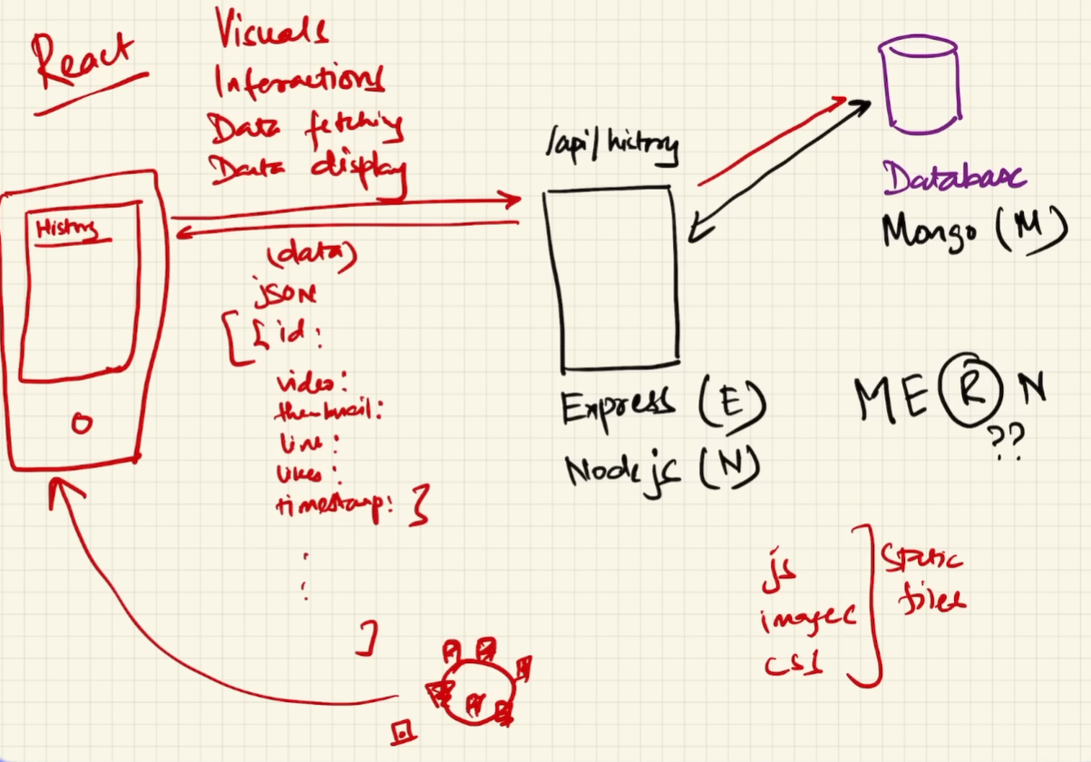
Notes:
CDN server are Netlify and Vercel (there can be other server). Static server and CDN are used interchangeably.
CDN in the context of the MERN stack typically stands for "Content Delivery Network."
API server and DataBase Express.js is a web application framework for Node.js, designed to build web applications and APIs quickly and efficiently. It provides a middleware support for handling requests and responses, routing, template engines, and much more.

Slide 3
React Tutorial
React is a JavaScript library for building user interfaces.
React is used to build single-page applications.
React allows us to create reusable UI components.
React, sometimes referred to as a frontend JavaScript framework, is a JavaScript library created by Facebook.
React only changes what needs to be changed!
Notes:
React is a JavaScript library created by Facebook.
React is a tool for building UI components.
React creates a VIRTUAL DOM in memory.
React only changes what needs to be changed!

Slide 4
React Installation
First check node version through cmd. Node -v
Install node.js if not installed
Npm create vite@latest
Give project name
Then go to project folder and install third party deficiencies npm i or(install)
Npm run dev.
Notes:
ReactDOM: ReactDOM is a package in React responsible for rendering React components into the DOM (Document Object Model). It provides methods for interacting with the DOM, such as rendering components, updating component states, and handling events.
createRoot: createRoot is a method introduced in React 18. It allows you to create a root for rendering React components inside a browser DOM node. This method initializes a new React root and returns an object representing it.
ReactDOM.createRoot(container) creates a new React root in the specified container (DOM node), enabling the rendering of React components within that container.

Slide 5
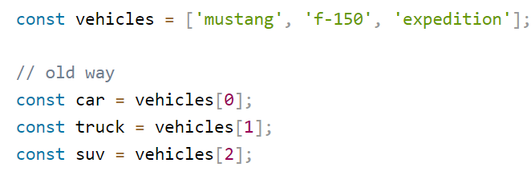
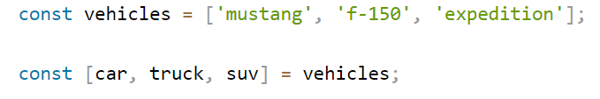
Destructuring:
Destructuring makes it easy to extract only what is needed.
Old way
New way
Notes:
JSX stands for JavaScript XML.
JSX allows us to write HTML in React.
JSX makes it easier to write and add HTML in React

Slide 6
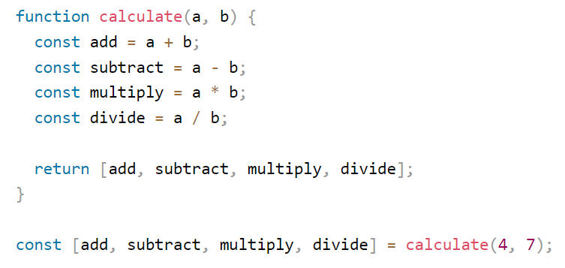
Example

Slide 7

Expressions in JSX
With JSX you can write expressions inside curly braces { }.
The expression can be a React variable, or property, or any other valid JavaScript expression.
JSX will execute the expression and return the result:

Slide 8
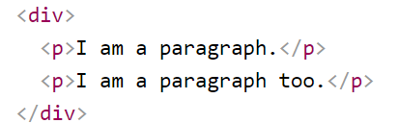
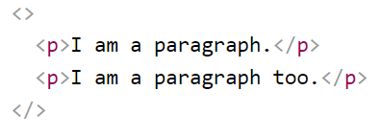
One Top Level Element
The HTML code must be wrapped in ONE top level element.
For Example:
This approach is not a good practice because we adding one extra tag div tag to the DOM.
To prevent unnecessarily adding extra nodes to the DOM. Use fragment. empty HTML tag: <></>.

Slide 9
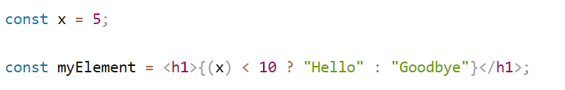
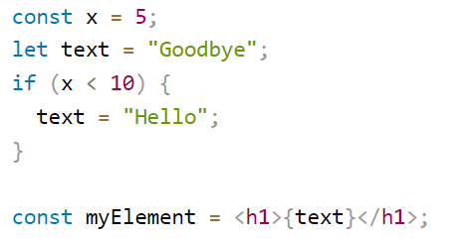
Attribute class = className and Conditions - if statements
The class keyword is a reserved word in JavaScript, Therefore not allowed to use it in JSX.
Use attribute className.
React supports if statements, but not inside JSX.
To be able to use conditional statements in JSX, put the if statements outside of the JSX, or use a ternary expression instead.

Slide 10
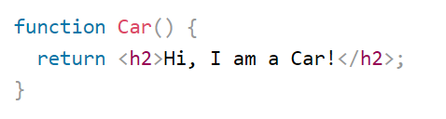
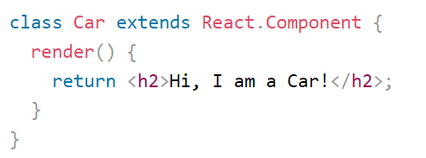
React Components
Components are like functions that return HTML elements.
Components are independent and reusable.
Components come in two types.
Class components
Function components
A class component must include the extends React.Component statement.
The component also requires a render() method, this method returns HTML.

Slide 11
Install Bootstrap
Npm i bootstrap@latest
Now how to import
import "bootstrap/dist/css/bootstrap.css";

Slide 12
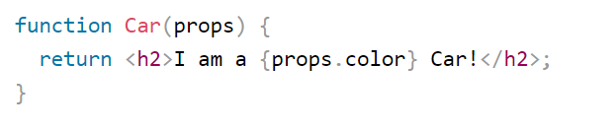

React Props
Components can be passed as props, which stands for properties.
Props are like function arguments, and we send them into the component as attributes

Slide 13
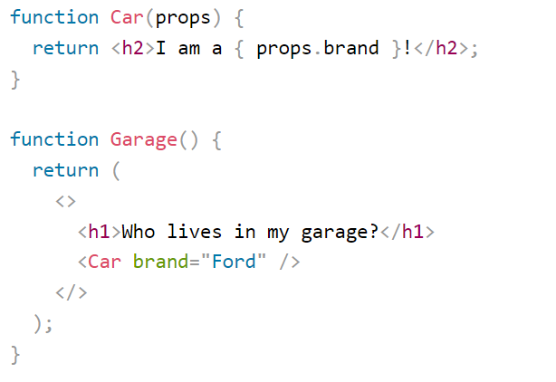
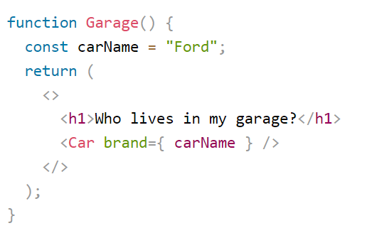
React Props

Slide 14
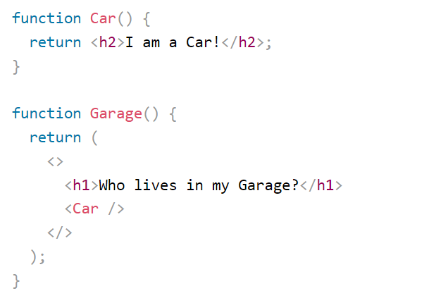
Components in Components
We can refer to components inside other components.
React is all about re-using code.

Slide 15
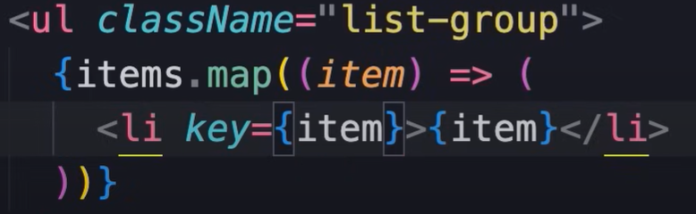
Map function
Notes:
Rendering content dynamically

Slide 16
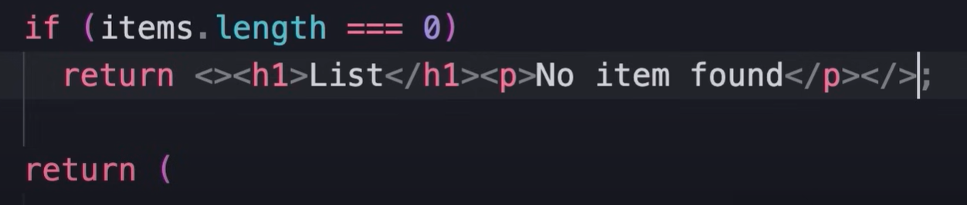
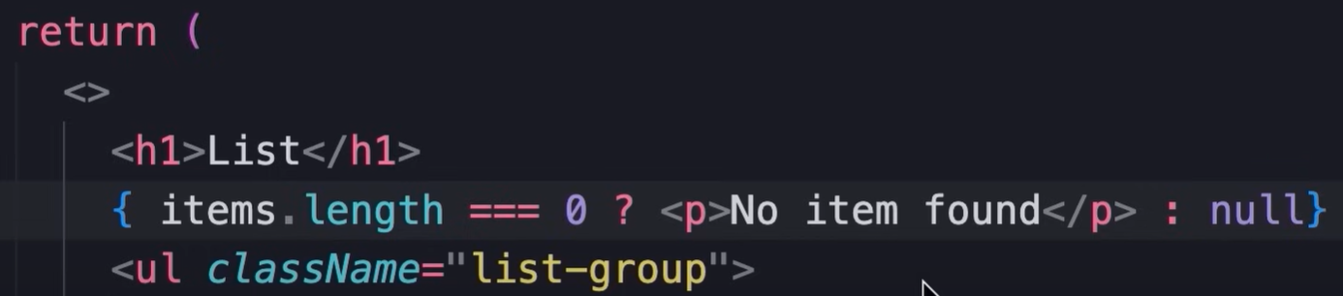
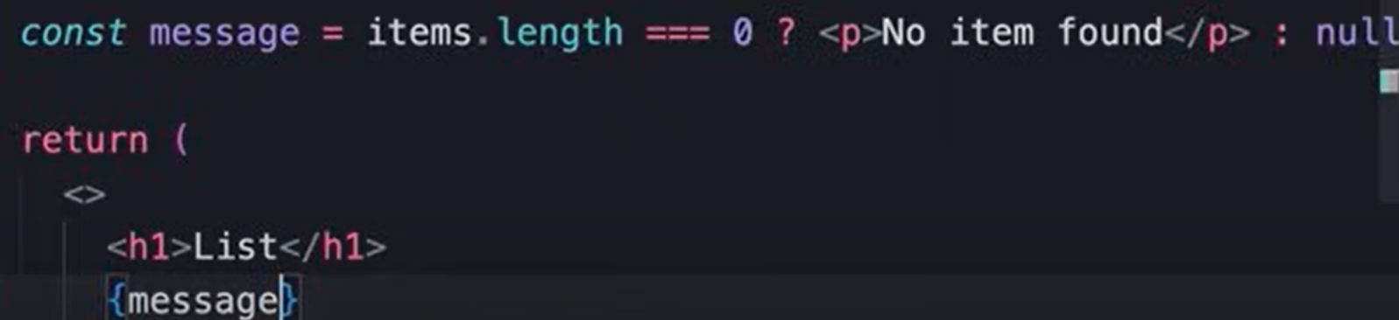
Conditional rendering

Slide 17
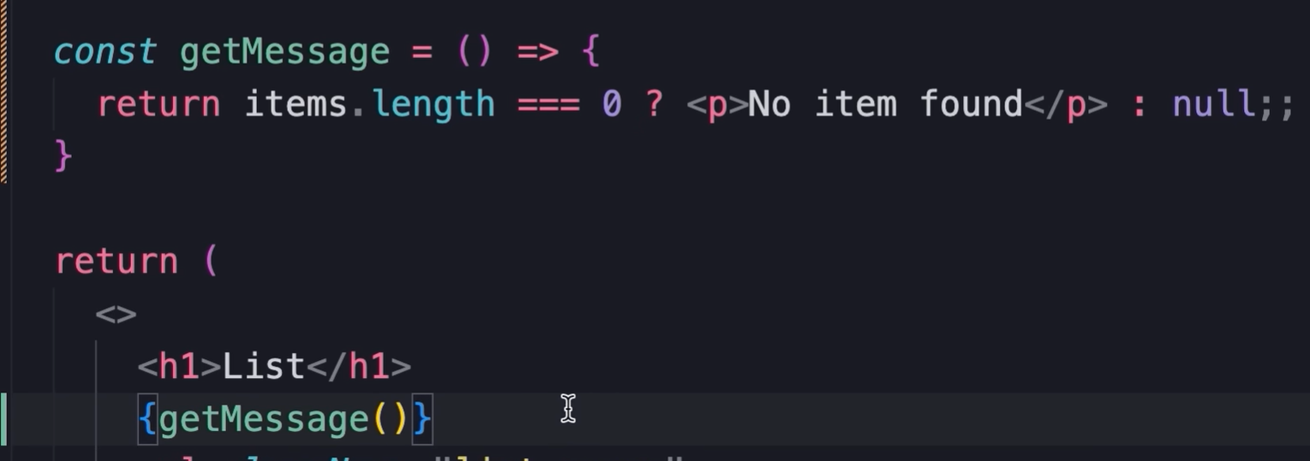
Conditional rendering

Slide 18
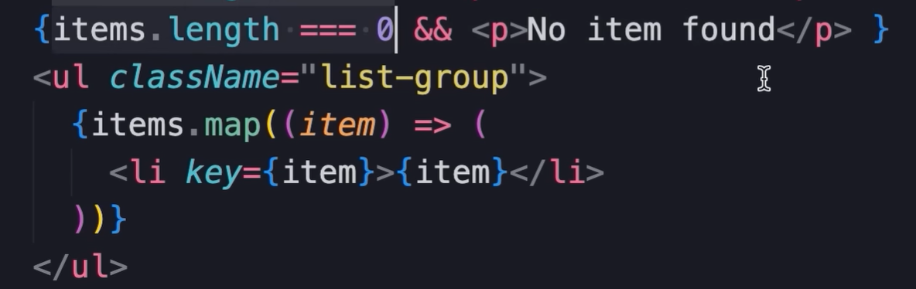
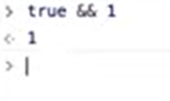
More concise and better way of Conditional rendering

Slide 19
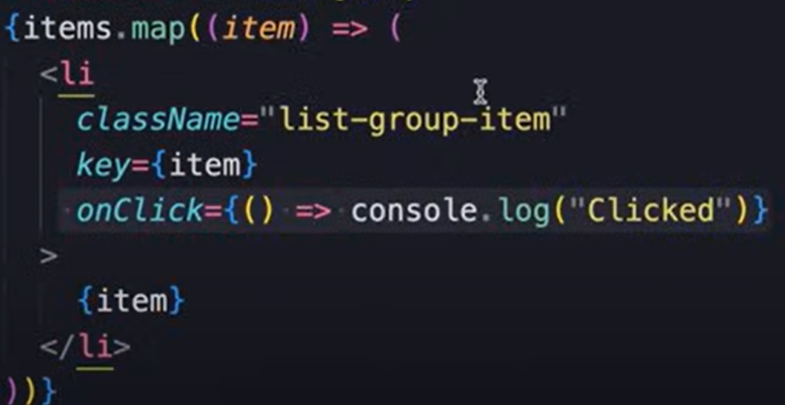

Handling events

Slide 20
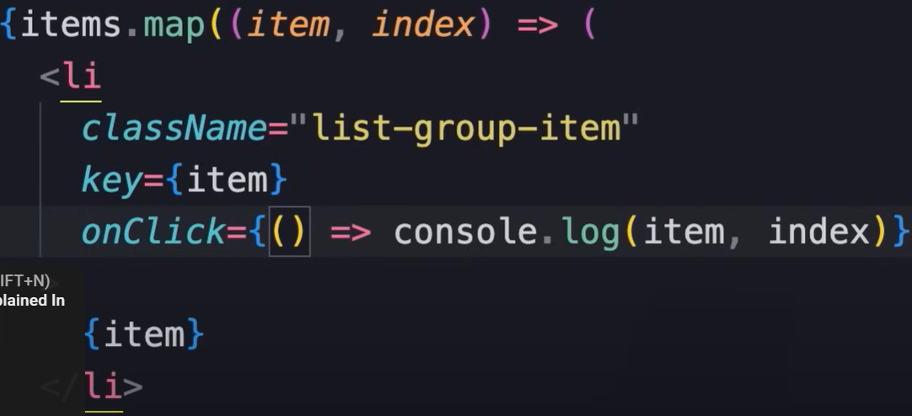
Handling events

Slide 21

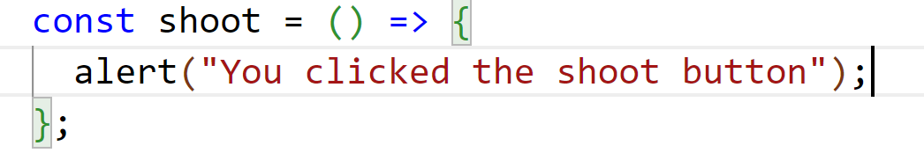
React Events
Just like HTML DOM events, React can perform actions based on user events.
React events are written in camelCase syntax:
onClick instead of onclick.
React event handlers are written inside curly braces:

Slide 22
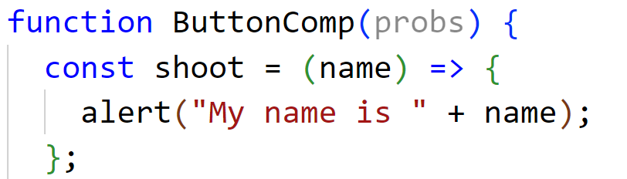
Passing Arguments to React Events

Slide 23
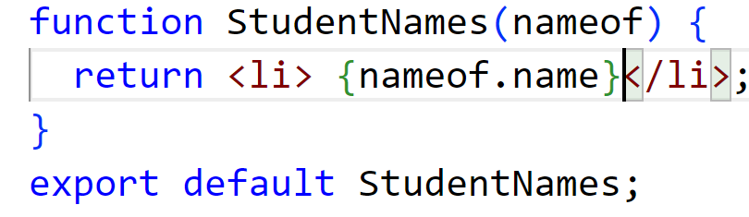
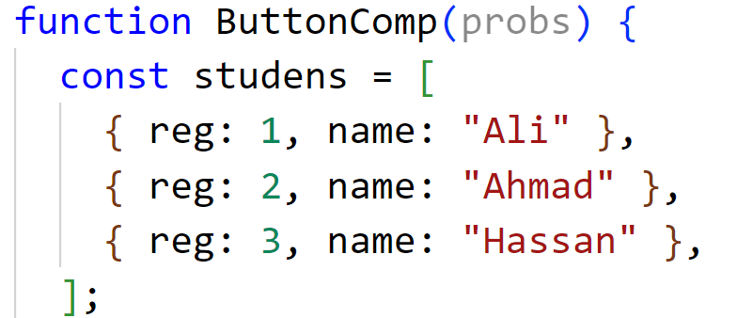
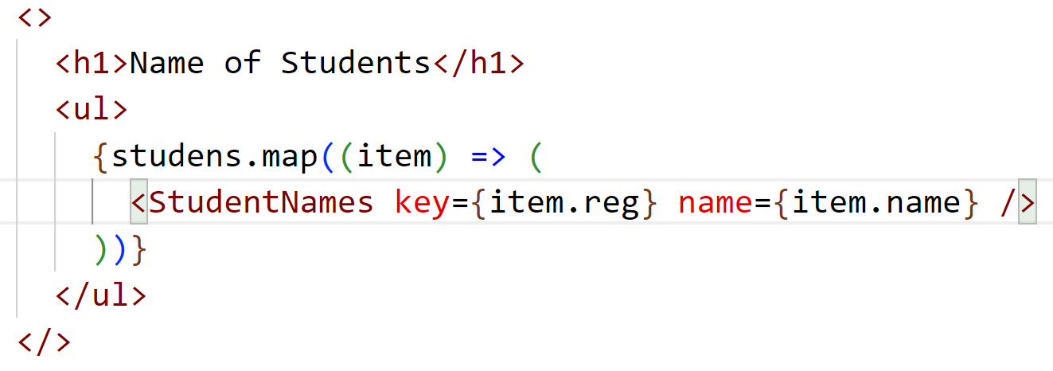
React List

Slide 24
React Event Object

Slide 25
React List

Slide 26
Adding Forms in React
In HTML, form data is usually handled by the DOM.
In React, form data is usually handled by the components.
When the data is handled by the components, all the data is stored in the component state.
We can control changes by adding event handlers in the onChange attribute.
We can use the useState Hook to keep track of each inputs value.

Slide 27
React Hooks
Hooks generally replace class components, there are no plans to remove classes from React.
Hooks allow function components to have access to state and other React features.
We must import Hooks from react.
Hook Rules
Hooks can only be called inside React function components.
Hooks can only be called at the top level of a component.
Hooks cannot be conditional.

Slide 28


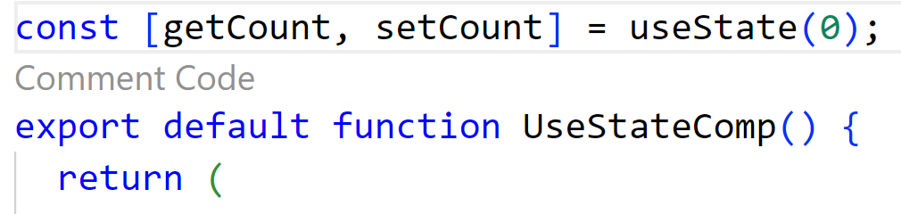
React useState Hooks
React useState Hook allows us to track state in a function components.
State generally refers to data or properties that need to be tracking in an application.
useState accepts an initial state and returns two values:
The current state.
A function that updates the state. a function components.
A variable that generally refers to data or properties that need to be tracking in an application.

Slide 29
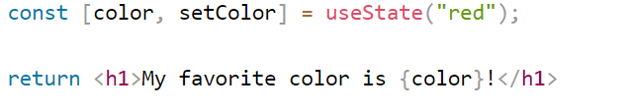
React useState Hooks
we are destructuring the returned values from useState.
The first value, getcount, is our current state.
The second value, setCount, is the function that is used to update our state.
We can now include our state anywhere in our component.

Slide 30
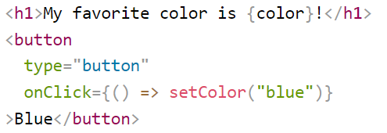
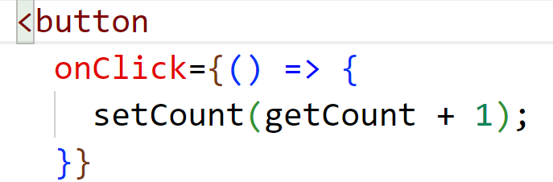
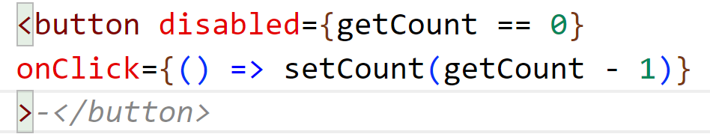
Update State

Slide 31

React Router
Create React App doesn't include page routing.
React Router is a library for React that enables navigation and routing.
It allows us to define routes, map them to different components, and handle navigation between them without reloading the page.
First, install React router in project
Notes:
Navigation and routing are related concepts often used in web development, especially in the context of single-page applications (SPAs), but they serve different purposes:
Navigation refers to the action of moving between different pages or views within a web application. It involves user interaction, such as clicking on links, buttons, or other UI elements to transition between different sections or views of the application. Navigation can occur within the same page (e.g., scrolling to a different section) or between different pages of the application. It focuses on the user experience and how users interact with and explore the content of the application.
Routing, on the other hand, is the mechanism that determines which component or view to render based on the current URL or location within the application.
It involves defining routes that map specific URLs or paths to corresponding components or views in the application.
Routing is typically managed by a routing library or framework (such as React Router for React applications or Vue Router for Vue.js applications).
It enables the application to handle dynamic content rendering and maintain a consistent UI state as users navigate through different sections of the application.
Routing is essential for SPAs, where the entire application is loaded initially, and subsequent navigation occurs without full page reloads.

